Slide 1




Development of Shelter Navigation with Considering Three Cs in the Corona Age
Hiroto Nakada
Himeji Nishi Senior High School 2nd grade
GSC-ROOT Program, Kobe University
Cooperated by
Toshiki Murotani
Masahide Nakamura
Graduate School of System Informatics, Kobe University
Notes:
Hello, everyone. My name is Hiroto Nakada.
Today, I’m going to make a presentation about “Development of Shelter Navigation with Considering Three Cs in the Corona Age”
こんにちは。
姫路西高校の中田ひろとです．
今から，私の研究，”Development of ….. “ コロナ時代の密を考慮した避難所ナビゲーションの開発を発表いたします．

Slide 2
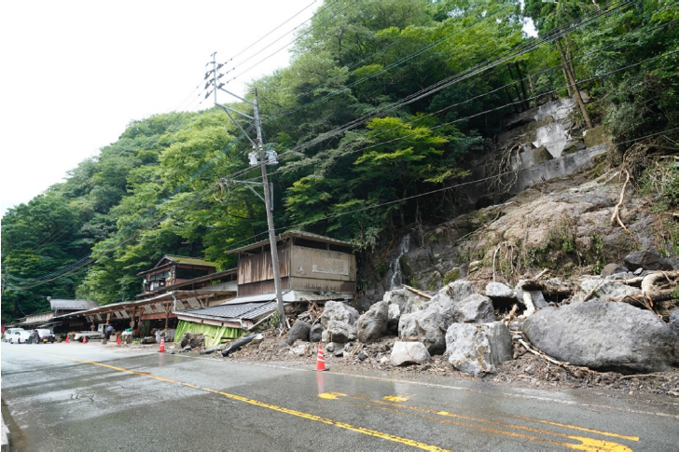
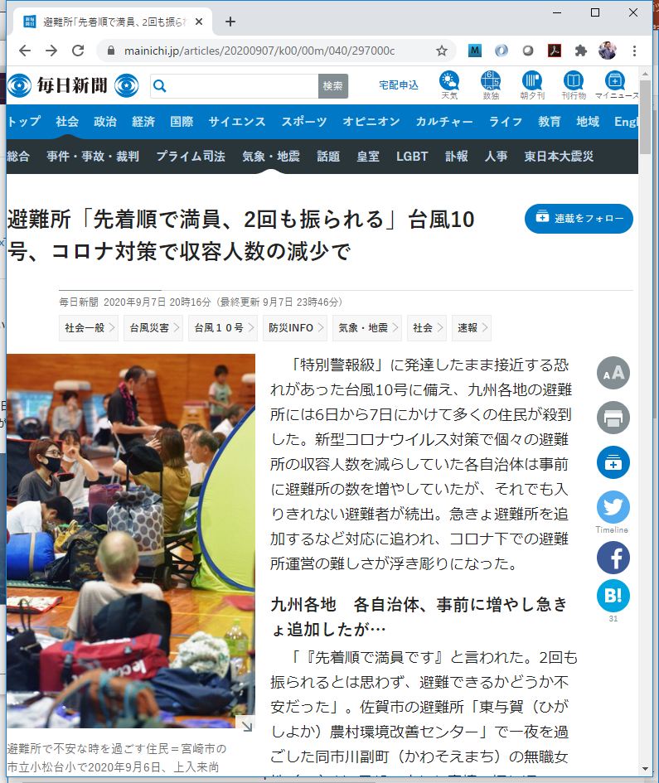
Disaster Evacuation in Japan
People fail to evacuate in disaster
Lack of awareness & preparedness
Normalcy bias: “My house may be safe”
Unaware of when/where to evacuate
COVID-19 makes things worse
Citizens hesitate to evacuate
Afraid of the risk of infection
The capacity of shelter is limited
Government wants to avoid 3C
Shelters may refuse to accept people*
How the disaster evacuation in the corona age should be?
*Source: CWMD, Kumamoto Univ. 2020-07
*Source: Mainichi Shinbun 2020-09-07
Notes:
Every years, many disasters happens in Japan. This picture was taken in Kumamoto after heavy rain disaster 2020.7.
Then, people fail to evacuate in disaster because of lack of awareness and preparedness, Normalcy bias and Unaware of when and where to evacuate.
In addition, COVID-19 makes things much worse. For example, citizens hesitate to evacuate because they are afraid of the risk of infection.
And the capacity of shelters is limited by local government to avoid 3Cs, therefore shelters may refuse to accept people.
In fact, Refusing to accept people was happen such this article.
How the disaster evacuation in the corona age should be?
日本は災害大国です．
毎年災害に見舞われ，多くの人が逃げ遅れによって，なくなっています．
これは，・・・・

Slide 3
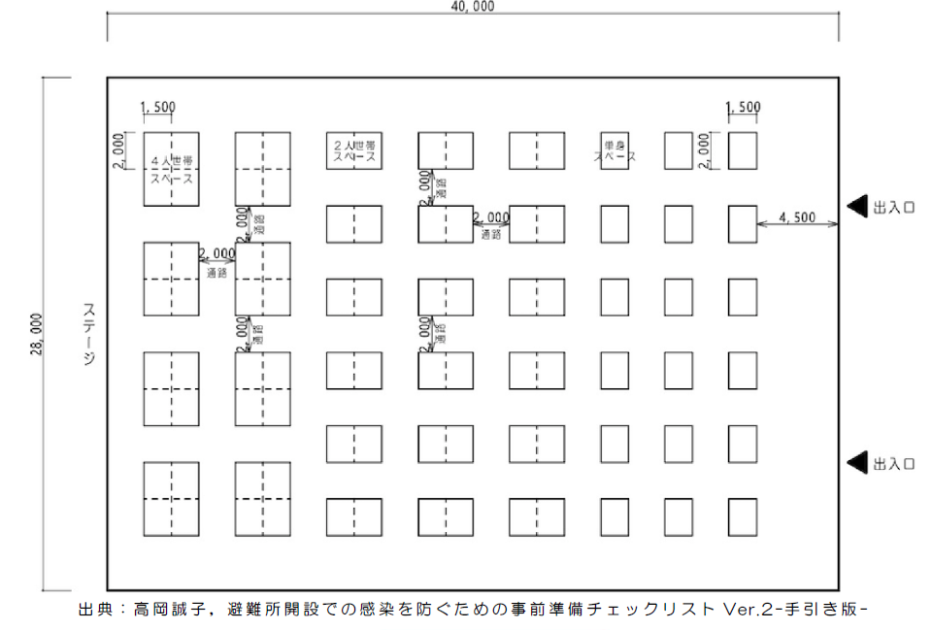
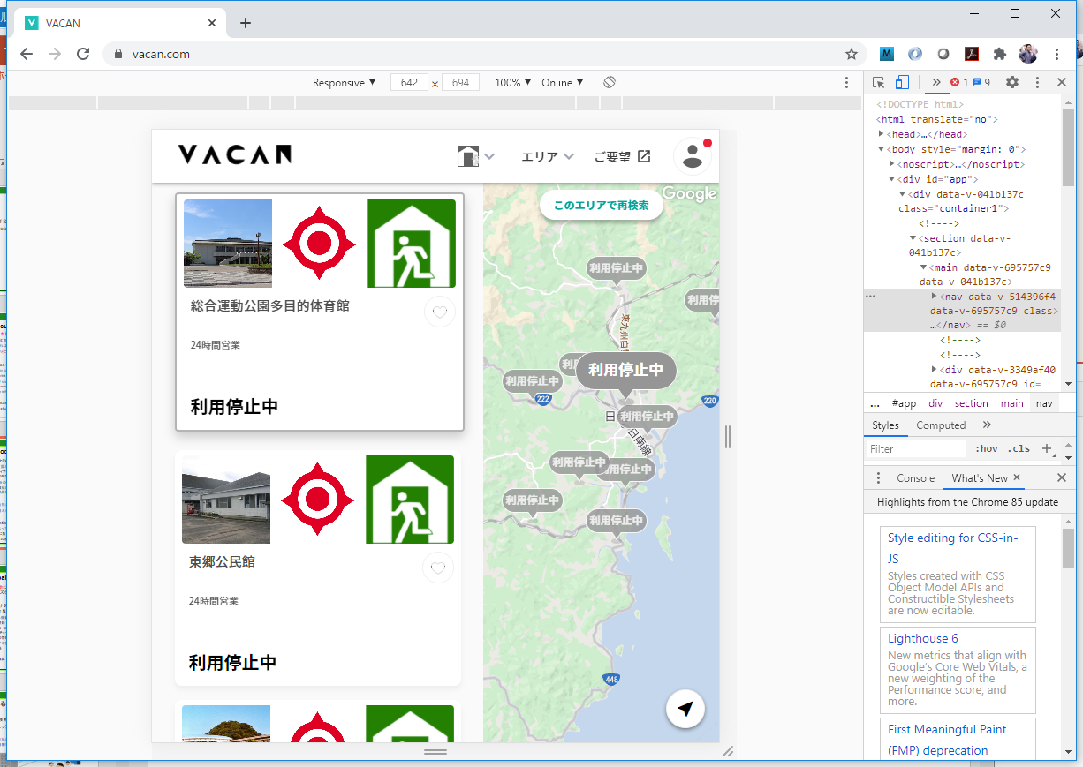



Struggles of Local Governments
Develop corona-aware evacuation shelters
New guideline avoiding 3Cs in shelters
Sparse Layout & Floor Plan, Thermometry, Health Inquiry, Phone-based Alert, Safety Confirmation…
Online Delivery of Congestion Information
Smartphone App “VACAN” (Nichinan-City, Miyazaki)
Staff manually update the status on site
Completely relying on local government
New policies add heavy workload to staff
Lack of scalability for # of citizens / shelters
Research Question
In the corona age, how can citizens find appropriate shelters by themselves, without relying on governmental staff?
Notes:
Local governments are thinking and doing new policies.
One of them is to develop corona-aware evacuation shelters.
They make a new guideline avoiding 3Cs in shelters. For example, space layout and floor plan, thermometry, health inquiry and phone-based alert etcetera.
This image is one example of that. People are separated each space per four or per two. And each space are separated by two meters.
Nichinan-City, Miyazaki started online delivery of congestion information by smartphone application, VACAN.
This is screenshot of VACAN. Each shelter status are shown with icon in the map.
But, this application needs staff’s manually updating the status on site.
Citizens are completely relying on local government.
New policies like this will add heavy workload to staff and result in lack of scalability for number of citizens and shelters.
So, my research question is “In the corona age, how can citizens find appropriate shelters by themselves, without relying on government staff?”

Slide 4


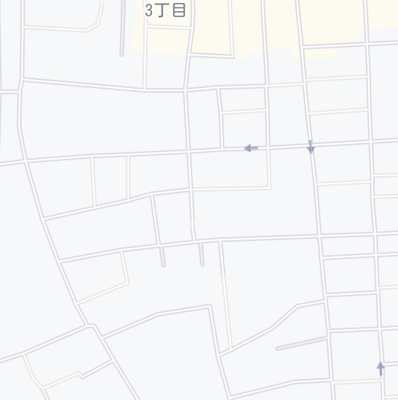




Research Goal and Approach
Research Goal
Achieve safe and smooth evacuation avoiding 3Cs in shelters by self-help effort of citizens
Approach
Develop Shelter Navi – A smartphone-based navigation app.
Cloud server manages location & status of shelters
Citizens search shelters with the status with app
As citizens “check in”, the system updates the status
search
Shelter name | Address | Max # of families | Current status
A high school | XX town 1-2 | 50 | 48
B element. school | YY town 4-5 | 30 | 20
C comm. center | YY town 11-4 | 10 | 6
D sports center | WW town 8-9 | 125 | 22
A
B
check-in
C
D
+1
Notes:
Our research goal is to achieve safe and smooth evacuation avoiding 3Cs in shelters by self-help effort of citizens.
We approach this research by developing “shelter navi”, a smartphone- based navigation application.
Cloud server manages location and status of shelters. This table shows each shelter status, name, address, Max number of family member, and current status.
In “A” high school, it can accept 50 people and 48 people evacuated. So A high school is crowded and the status are shown in red.
D sports center is vacant. So the statue of D sports center is shown in green.
citizens can search shelter and the status with this application on smartphone.
Citizen’s current position is shown as a blue circle on the map.
Citizens evacuate to the vacant shelter following the map.
As citizens “check in”, the system updates the status.

Slide 5


Citizen’s Use Cases
C1: Register household information
Name, home address, email, phone, # of family member
C2: Search shelters
System visualizes shelters with congestion status on a map
With the map, citizen searches a shelter to evacuate
C3: Check-in at shelter
Citizen moves to the shelter, and presses “Check-In” button
System records the check-in, and updates the status of the shelter
Crowded
Disaster Alert
NAME:
Hiroto Nakata
ADDRESS:
X town 33-2
EMAIL:
hiroto@aaa.jp
PHONE:
079-9123-4567
# of FAMILY: 4
2020-10-03 12:00
Muronani Toshiki
Check in at
D Sports Center
check in
2020-10-03 12:05
Nakada Hiroto
Check in at
D Sports Center
Notes:
I will talk about citizens use cases.
First, citizens need to register household information to use ”Shelter Navi”.
Name, home address, email, phone, and number of family member.
Second, citizens can search shelters.
When disaster occurs, system visualizes shelters with congestion status on a map.
With the map, citizens searches a shelter to evacuate.
Third, when citizens moves to the shelter,
and presses “check-in” button,
system records the check-in, and updates the status of the shelter.

Slide 6

Local Government’s Use Cases
G1: Register shelter information
Shelter name, address, lat, lng, capacity, description
G2: Check status
System shows the current status of every shelter
Staff checks if the status matches the real situation
G3: Confirm safety of particular citizen
System shows the list of evacuated citizens at every shelter
Staff confirms the safety of any particular citizen
Shelter name | Address | Max # of families | Current status
A high school | XX town 1-2 | 50 | 48
B element. school | YY town 4-5 | 30 | 20
C comm. center | YY town 11-4 | 10 | 6
D sports center | WW town 8-9 | 125 | 22
Disaster Alert
SHELTER NAME:
A High School
ADDRESS:
XX town 1-2
Lat-Lng: 134.6867,34.8434 Max # of families:
50
List of Citizens D sports Center
-----------------------------
NAME CHECK-IN #
---------------------------------
Nakada H. 12:00 5
Murotani T. 12:05 4
：
Crowded
Notes:
Next, I will talk about local government‘s use cases.
First, local governments need to register shelter information.
Shelter name, address, lat-lng, capacity and description.
Second, staff can check the status of shelters.
System shows the current status of every shelter, and staff can checks if the status matches the real situation.
Third, System shows the list of evacuated citizens at every shelter,
and staff can confirm the safety of any particular citizens.

Slide 7








System Architecture
Implement Shelter Navi as Web Application
Server Side: Layered Architecture with REST-API
Java Web Service with Spring Boot
Integrated with Google Maps
Client Side: HTML/JS on Web browser
Responsive Web design with Bootstrap
Client-Side
Server-Side
Citizen Web-API
Government Web-API
REST Controller
Business Logic
Internet
Citizens
Data Base
Map Service
Google Maps Platform
Government
Notes:
We implement Shelter Navi as Web Application.
Server side takes a layered architecture with REST-API.
This application is Java web service with Spring Boot and integrated with Google Maps.
Data Base is made up by MySQL.
Client side is implemented(インプルメント) by HTML and JavaScript on Web browser and use Bootstrap for Responsive Web design.

Slide 8
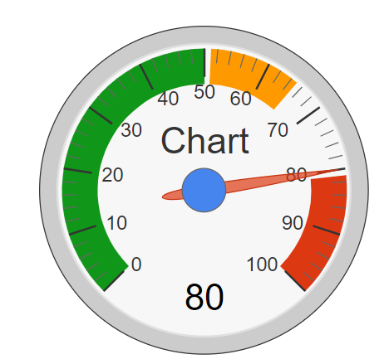
Technical Details
Domain modeling
Shelter: sid, name, address, lat, lng, capacity, isActive, manager
Citizen: cid, name, email, password, home address, # of families
Check-In: id, cid, sid, check-in datetime, check-out datetime
Search shelters by distance
Obtain current (x,y) from GPS
Find shelters S(lng, lat) such that ; d(lng, lat) = 6371 * acos (cos(rad(y)) * cos(rad(lat)) * cos(rad(lng) – rad(x)) + sin(rad(y))*sin(rad(lat))) <= D
Calculate density of shelter
CheckIn(S): # of families currently checked in S
Capacity(S): Max # of families S can accommodate
Density(S) = CheckIn(S) / Capacity(S)
Shelter
1
0..*
Check-In
Citizen
0..*
1
D
Notes:
I will talk about technical details.
First, Domain modeling defines data structure and relationships of Shelter Navi. The main entities are shelter and citizen and check-in.
Each entity as these data items and check-in records which citizen is in which shelter.
Second, How does the system search shelters by distance?
System obtains current (x,y) from GPS and find shelters S(lng,lat) such that this equation is satisfied.
This equation searches the shelters whose coordinates are nearer than distance(D) form current position (x,y)
Third, how does the system calculate density of shelter?
CheckIn(S) represents the number of families currently checked in S.
Capacity(S) represents the max number of families S can accommodate.
Density(S) equal CheckIn(S) divided by Capacity(S).
///////////
(Shelter’s data is shelter-id, name, address, latitude, longitude, isActive, and manager.
Citizen’s data is shelter-id, name, email, password, home address and number of families.
Check-in‘s data is id, shelter-id, citizen-id, check-in datetime and check-out datetime.)

Slide 9
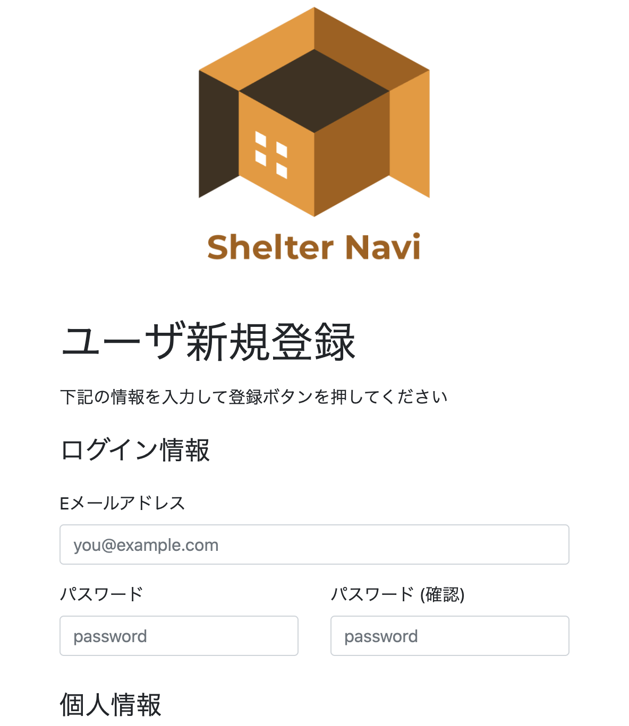
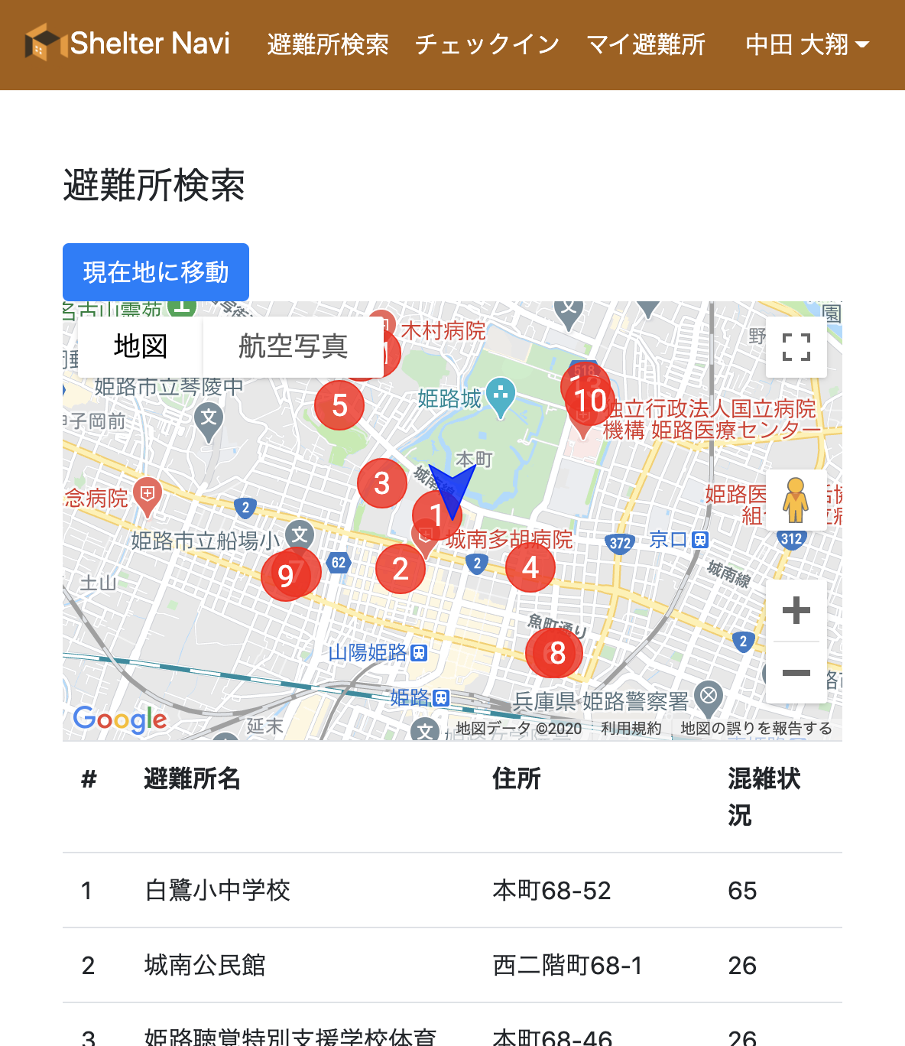
Screenshots of Prototype
We are currently implementing Shelter Navi with open data of Kobe City and Himeji City
Notes:
We are currently implementing Shelter Navi with open data of Kobe City and Himeji City.
These are screenshots of Prototype.
This screen shows user registration screen where the citizen registers personal information.
This screen shows shelter search screen in which the position of each shelter is marked by a circle.
Below shows the shelters name and address and capacity.

Slide 10
Discussion
Advantage of Shelter Navi
Citizens can find vacant shelters by themselves
Shelter congestion is measured automatically by the system
Government staff can check the real-time status of every shelter
Limitations
Strict data management is needed (info, capacity, open/close)
Not easy for people unfamiliar with smartphone operations
Rely on mobile network infrastructure
Advanced Use Cases
Manage private shelters (houses of relatives/friends)
Integrate with public/local disaster information
Experimental Evaluation in Real Settings
Cooperation by local governments is inevitable
Notes:
Next, I will describe advantage of Shelter Navi.
/
/
/
But, there are some limitations.
/
/
/
We are also considering advanced use cases.
Manage private shelters (houses of relatives/friends) and Integrate with public/local disaster information.
Cooperation by local governments is necessary to do experimental evaluation in real settings.

Slide 11
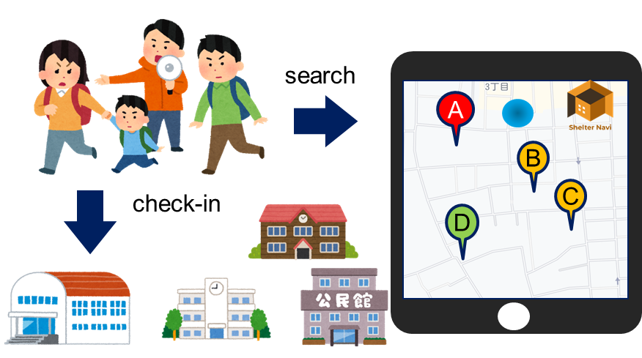
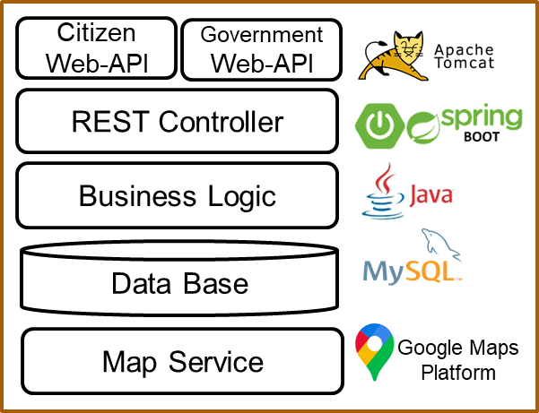
Summary
Study and develop Shelter Navi for disaster evacuation navigation in the corona age
Achieve safe evacuation with avoiding 3Cs in shelters by self-help effort of citizens
Presented basic use cases and system design
Ongoing Work
System development with Nakamura Lab. in Kobe University
Experimental evaluation in practical setting
Notes:
Summary,
In this research, I study and develop Shelter Navi for disaster evacuation navigation in the corona age.
Research goal is to Achieve safe evacuation with avoiding 3Cs in shelters by self-help effort of citizens.
I presented basic use cases and system design like this.
Ongoing works are System development with Nakamura Lab. in Kobe University
and Experimental evaluation in practical setting
That’s all. Thank you very much for kind attention.

Slide 12
謝辞
神戸大学大学院システム情報学研究科
中村 匡秀 先生
室谷 敏生 様
JSTグローバルサイエンスキャンパス ROOTプログラム

Slide 13

5.アプローチ
『Shelter Navi』を開発する
自宅周辺の避難所を地図上に表示するとともに、避難所の混雑状況をリアルタイムで確認できるアプリケーション

Slide 14
6.提案手法
機能
避難所の混雑状況の確認
リアルタイムの情報を確認可能
地図上に表示
チェックイン・チェックアウト機能
住民がどこに避難したかが確認可能
これにより避難所の収容率を計算（職員の入力作業不要）
私的な避難所（Private Shelter)の登録
新たな避難様式に対応

Slide 15
評価

